Slide 1
BloodLife
Presented By: Gennaro Finelli & Karl Alvarado

Slide 2
Description Of The Project
BloodLife is a mobile application that allows its users to log into their accounts and register for any upcoming blood drives that are taking place.
The application has a total of 10 screen flows.
The database chosen for this application is SQLite.
GitHub Link:
https://github.com/gennarofinelli/AppDev2Project

Slide 3

Splash Screen
The splash screen will be the first thing the user sees upon opening the application.
It will last for only a couple of seconds.

Slide 4
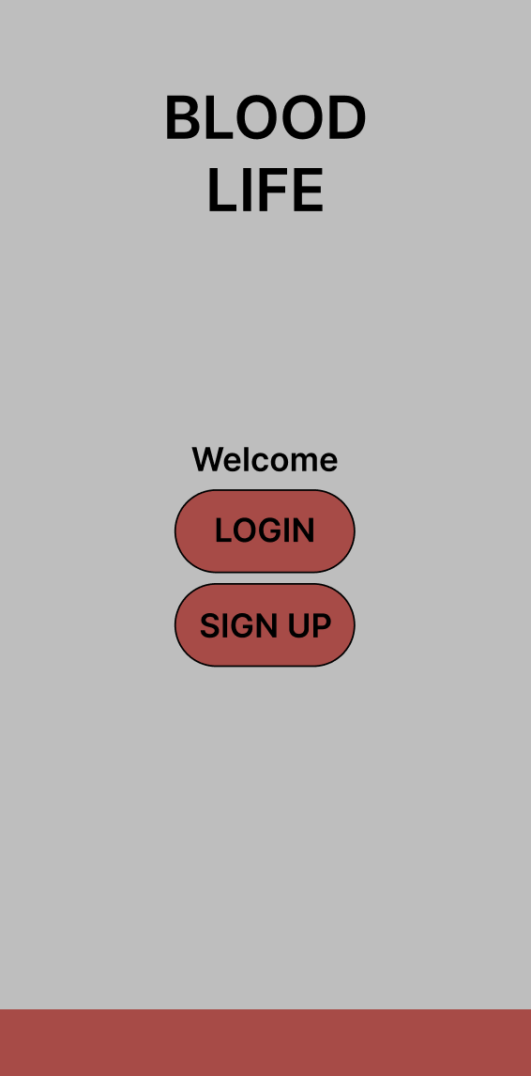
Start Page
The start page presents the user with two buttons:
The first allows the user to login to an existing account
The second allows the user to sign up if they’re new to the application.

Slide 5
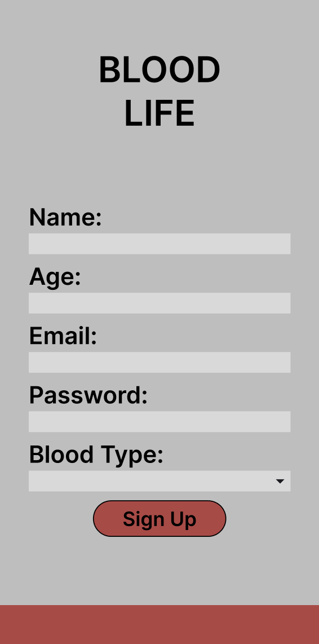
Sign Up Page
The sign up page requests the user to input their name, age, email, password, and their blood type.
If all inputs are valid, the user gets stored into the database and brought back to the start page.

Slide 6
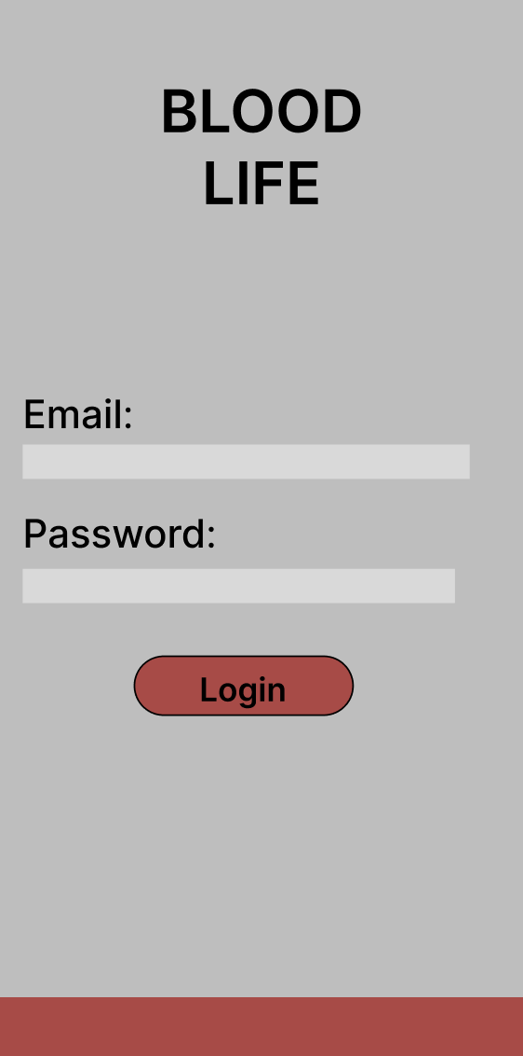
Login Page
The login page requests the user to input their email and password to login to their account.
If successful, they’re brought to the home page.

Slide 7
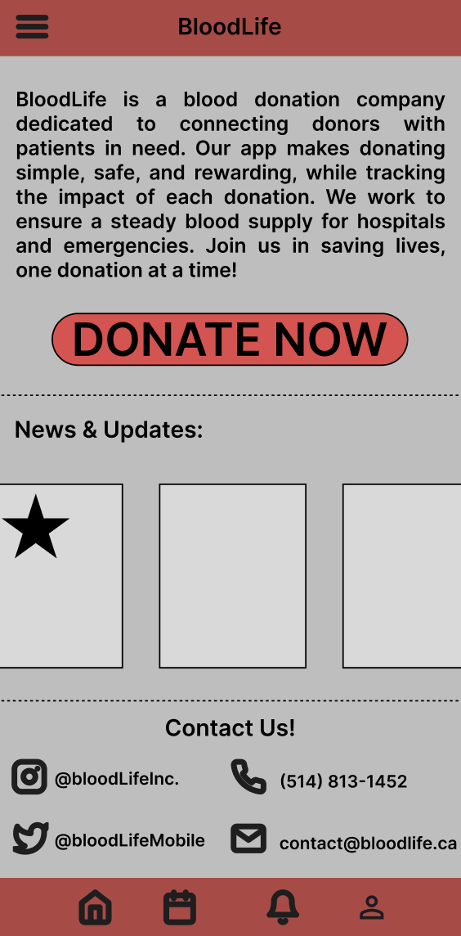
Home Page
The home page shows the user a brief summary of BloodLife.
There is also a section that shows the user a few news panels that can show the upcoming blood drives.
There is a contact section that shows the user where they can reach BloodLife.
There is a nav bar located at the bottom with the main pages that the user wants to access.
There is a dropdown menu that will have smaller things such as settings or other pages.

Slide 8
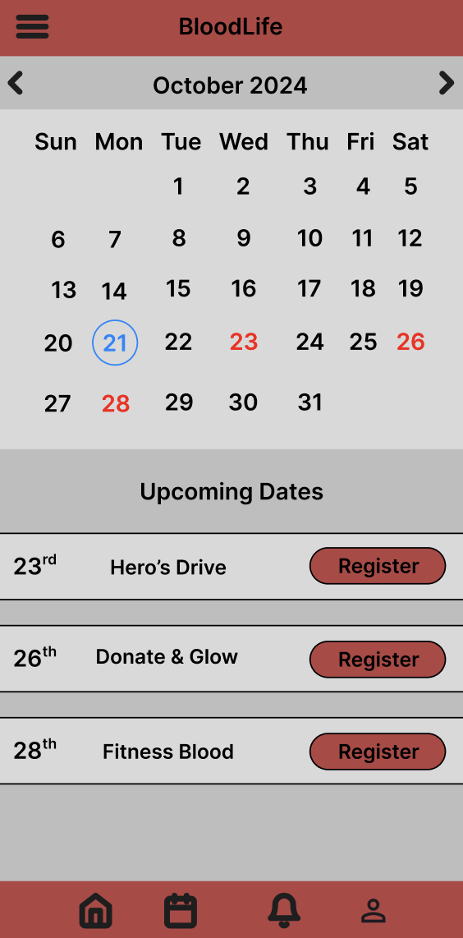
Booking Page
The booking page has a calendar on the top section of the page that highlights the current date in blue, and upcoming event dates in red.
The bottom of the page allows the user to view any of the upcoming events and register to attend one of the blood drives.

Slide 9
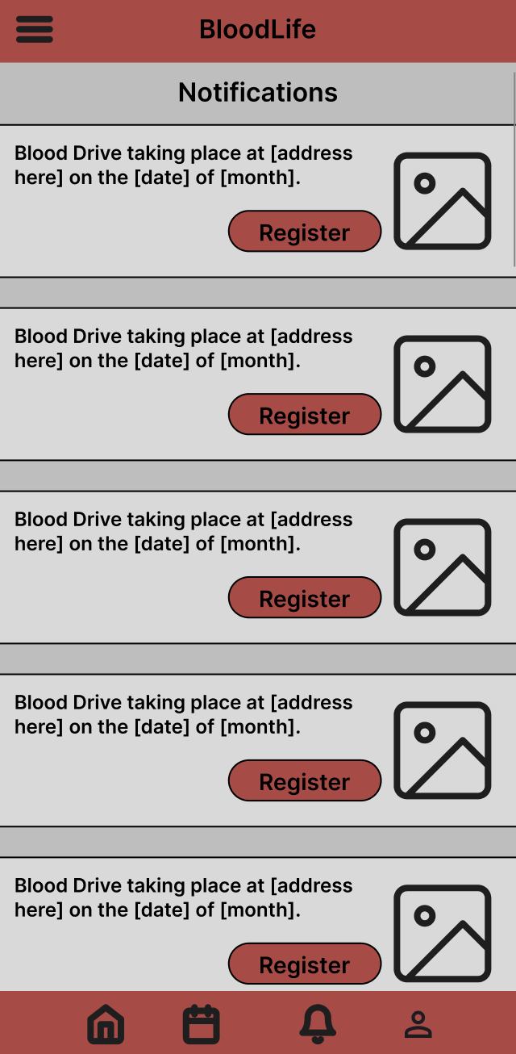
Notifications Page
The notifications page shows all events past and upcoming.
This page shows details about the event such as the:
Location
Date

Slide 10
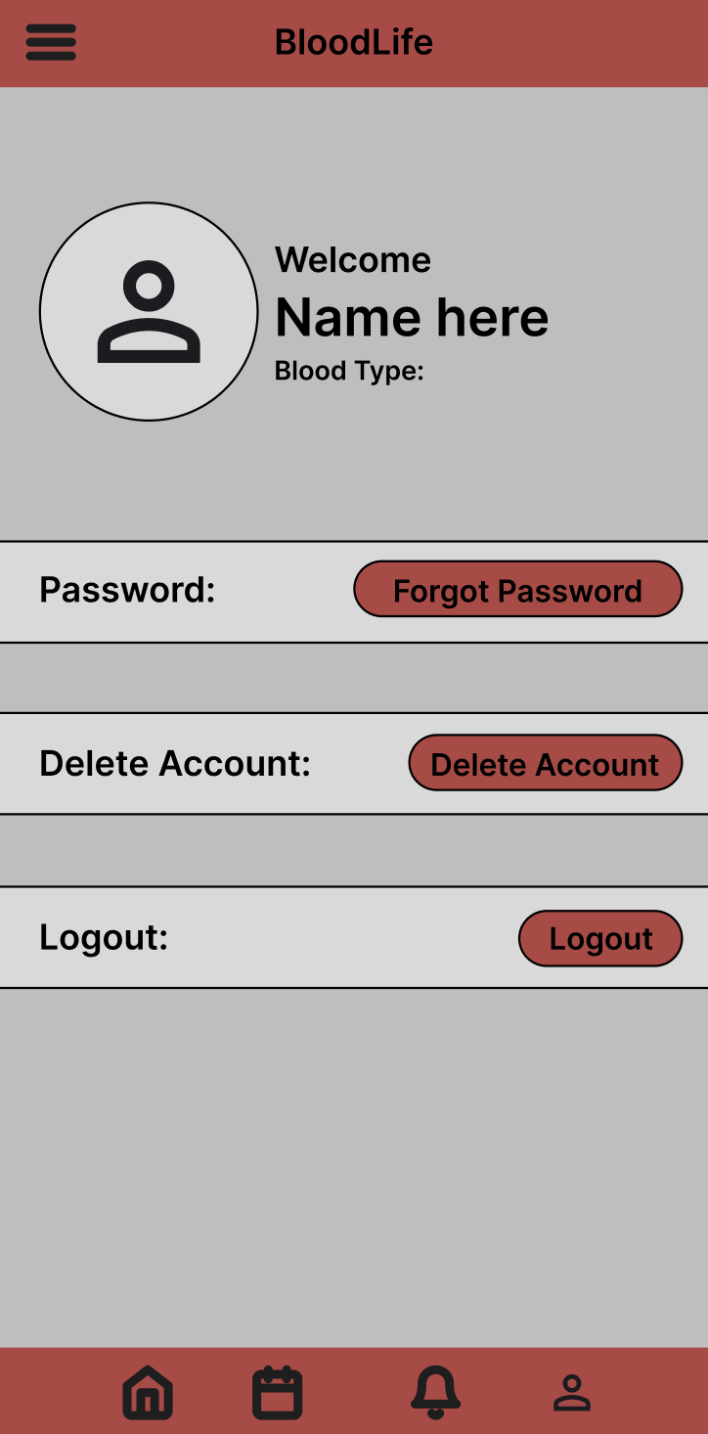
Profile Page
The profile page will allow the user to change their password, delete their account or logout of their account.

Slide 11
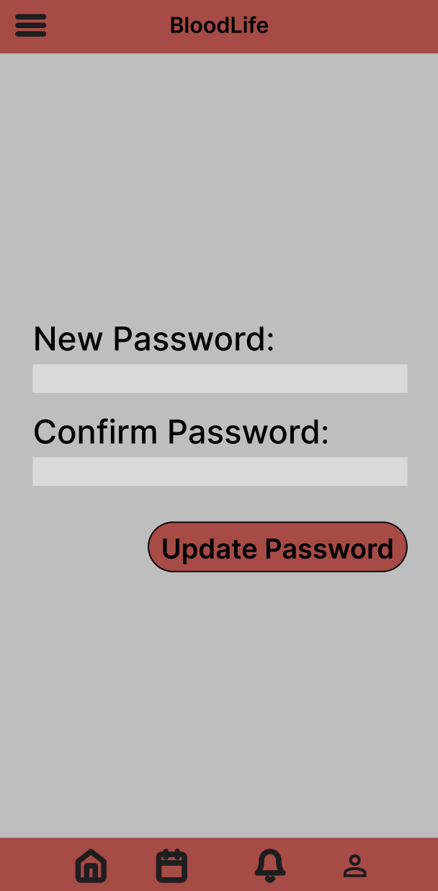
Forgot Password Page
The forgot password page will allow the user to change their password only if they input a valid password.

Slide 12
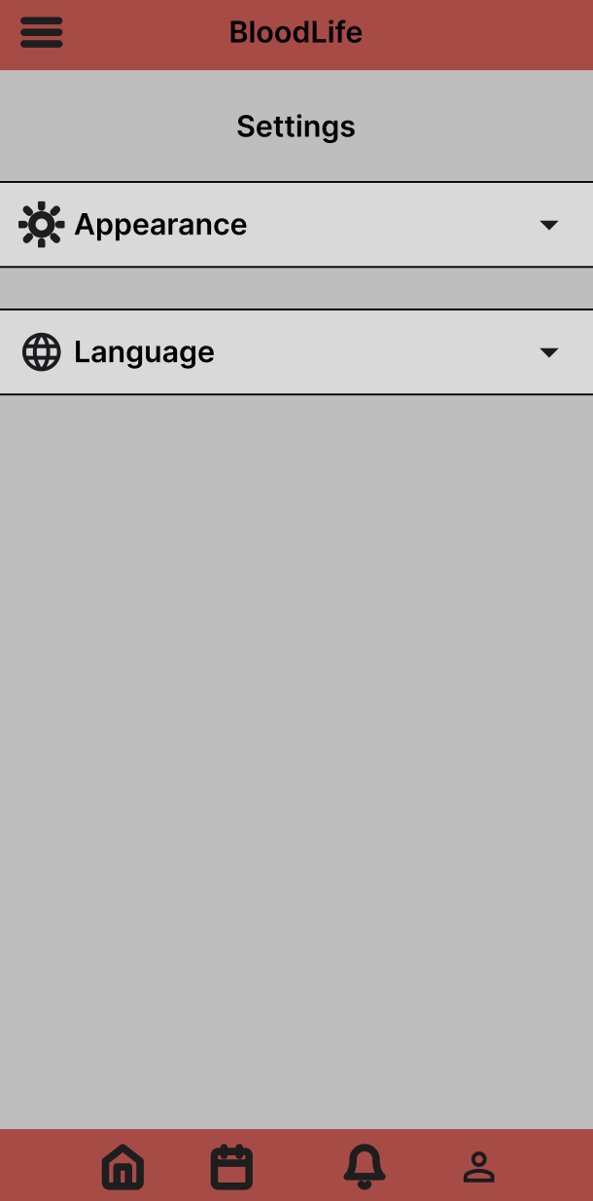
Settings Page
The settings page will allow the user to change certain aspects about the application such as:
The theme
The language

